Slide 1


Hii,
Iam Siddhika
Welcome to Power BI Series
Part -68

Slide 2



I’m very excited to dive into this with you all!
Are you ready to enhance your data visualization skills?
We focus only on the most used and important Visuals
Today Content
VISUALIZING DATA
AI VISUALS
DECOMPOSITION TREE KEY INFLUENCERS

Slide 3
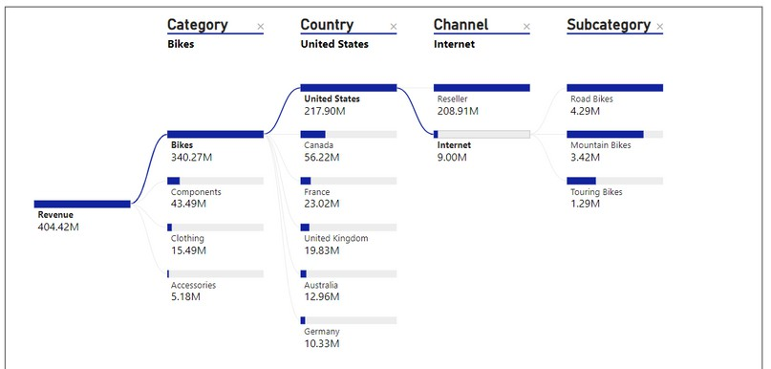


DECOMPOSITION TREE
A Decomposition Tree helps you break down and analyze data across multiple dimensions. It allows users to decompose a measure (like total sales) into its contributing factors, helping to uncover insights and understand the factors driving a metric.
Go and
explore
formatting of
DECOMPOSITI
ON TREE
When to Use:
Finding Causes: To see what factors lead to a result.
Exploring Data: To look at data in a detailed way.
Making Decisions: To understand what drives your metrics and make better decisions.

Slide 4
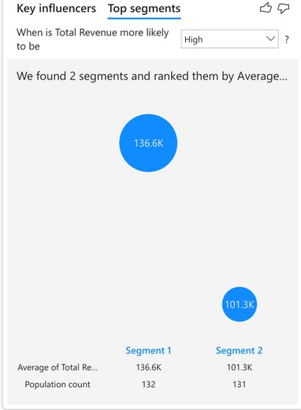


KEY INFLUENCERS
Go and explore
KEY INFLUENCERS
The key influencers visual helps you understand the factors that drive a
metric you're interested in. It analyzes your data, ranks the factors that matter, and displays them as key influencers.
For example, suppose you want to figure out what influences employee turnover, which is also known as churn. One factor might be employment contract length, and another factor might be commute time.
When to Use: The key influencers visual is a great choice if you want to:
See which factors affect the metric being analyzed. Contrast the relative importance of these factors.
For example, do short-term contracts affect churn more than long-term contracts?

Slide 5


Thank you for joining me today to learn about Part -68 of Power BI!
Remember, Effective data visualization is crucial for turning data into meaningful insights and compelling narratives with Power BI.
Stay tuned for more insights and tips on Power BI in our next Series.
Follow
Siddhika Shah

